Slide 1
Computer Vision
(Fall 2017)
Problem Set #1
Zhi Zhang
zhizhang@gatech.edu
Computer Vision @ GT

Slide 2
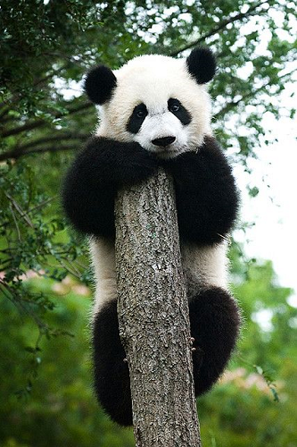
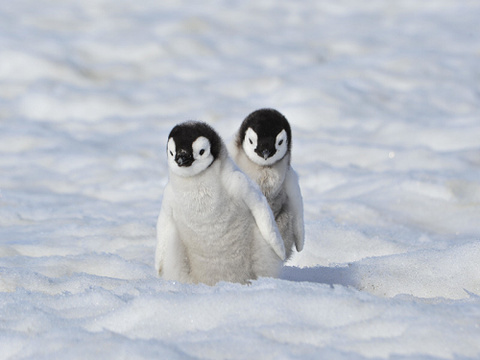
1a: Interesting Images
Image 1 - ps1-1-a-1.png
Image 2 - ps1-1-a-2.png
Computer Vision @ GT

Slide 3
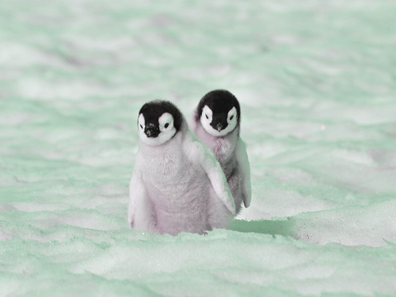
2a: Swapped Green and Blue
ps1-2-a-1.png
Computer Vision @ GT

Slide 4
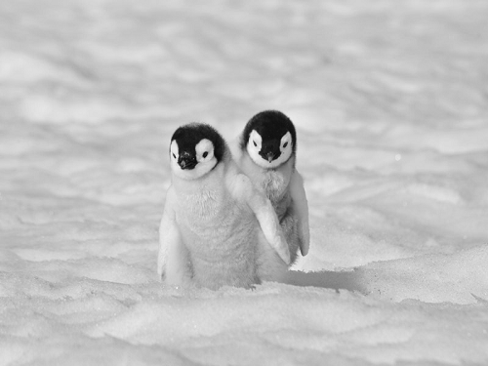
2b: Monochrome Green
Img1_green - ps1-2-b-1.png
Computer Vision @ GT

Slide 5
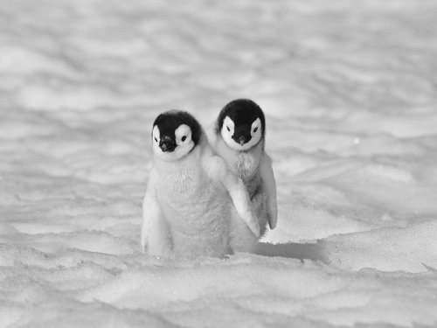
2c: Monochrome Red
Img1_red - ps1-2-c-1.png
Computer Vision @ GT

Slide 6
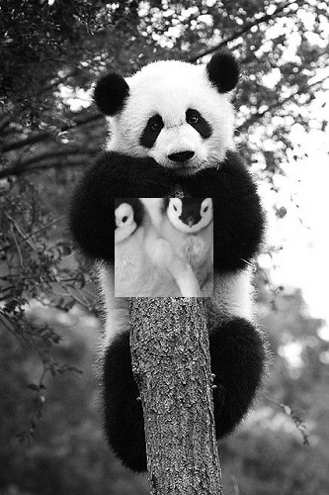
3a: Replacement of Pixels
ps1-3-a-1.png
Computer Vision @ GT

Slide 7
4a: Image Stats
Min, max, mean, and standard deviation
('The min pixel value of img1_green is', 9.0)
('The max pixel value of img1_green is', 243.0)
('The mean pixel value of img1_green is', 193.59426666666667)
('The std dev of img1_green is', 26.144131051963114)
Computer Vision @ GT

Slide 8

4b: Arithmetic Operation
ps1-4-b-1.png
Computer Vision @ GT

Slide 9

4c: Shifted Image
ps1-4-c-1.png
Computer Vision @ GT

Slide 10
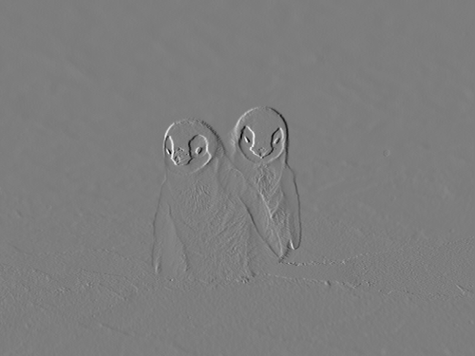
4d: Difference Image
ps1-4-d-1.png
Computer Vision @ GT

Slide 11
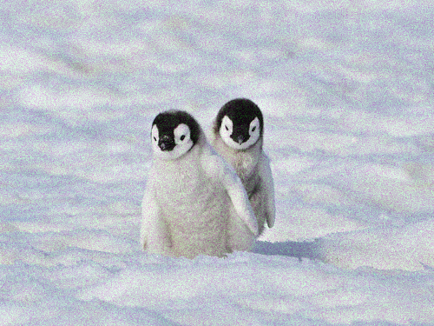
5a: Noisy Green Channel
ps1-5-a-1.png
Computer Vision @ GT

Slide 12
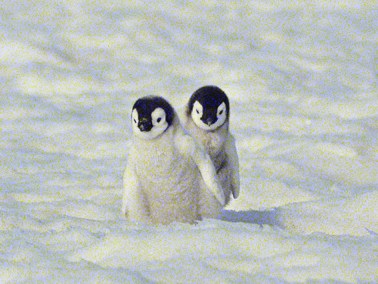
5b: Noisy Blue Channel
ps1-5-b-1.png
Computer Vision @ GT

Slide 13
6: Discussion
Between all color channels, which channel, in your opinion, most resembles a grayscale conversion of the original. Why do you think this? Does it matter for each respective image? (For this problem, you will have to read a bit on how the eye works/cameras to discover which channel is more prevalent and widely used)
The green channel most resembles the grayscale conversion of the original.
There are two reasons, the first reason is that I have observed the green channel has the minimum differentiation than the grayscale conversion of the original (see below comparison figures); the second reason which is the behind reason is that I have learned from books that the RGB are signal intensities values recorded by a color camera in responses of the three types of cones for the human eye, and the most commonly used pattern in color cameras today is the Bayer pattern, which places green filters over half of the sensors, and red and blue filters over the remaining ones (ref: Computer Vision – Algorithms and Applications, pg86). So there are twice as many green pixels as red and blue, and it’s because the luminance signal is mostly determined by green values. Because of this, the images from the color cameras has the green channel dominantly, and the red and blue channels have more spectral noise when the RGB triplets are reconstructed from adjacent sensor pixels. Also, it doesn’t matter for each respective image.
Computer Vision @ GT

Slide 14

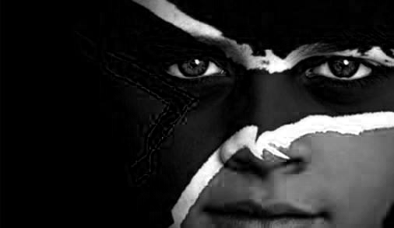
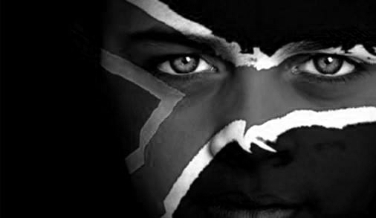
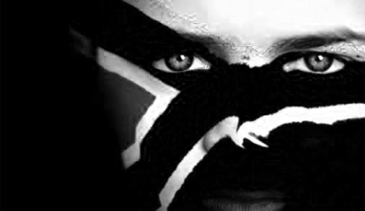
6: Discussion
a Continuous:
Grayscale
Blue
Green
Red
Computer Vision @ GT

Slide 15
6: Discussion
What does it mean when an image has negative pixel values stored? Why is it important to maintain negative pixel values?
Besides the RGB coordinates which are positive, there are some negative coordicates that used to model some luminance signal existed but fall outside of the RGB color spaces, such as the infrared (ref: https://www.mathworks.com/matlabcentral/answers/39380-negative-values-of-pixels-in-aimage) So the negative pixel values are important to model those signals that can’t be approximated by the RGB, such as signals in medical x-ray images, astronomical pictures.
Computer Vision @ GT

Slide 16
6: Discussion
In question 5, noise was added to the green channel and also to the blue channel. Which looks better to you? Why? What sigma was used to detect any discernable difference?
The blue channel looks better to me.
The reason behind is that the eye is most sensitive to green, least sensitive to blue. Because the luminance signal from light is mostly determined by green values and the visual system is much more sensitive to high frequency detail in luminance than in chrominance (ref: Computer Vision – Algorithms and Applications, pg86). Since the luminance or brightness is composed mostly of the green signal, and most scene illumination is deficient in blue light relative to green and red, and the lack of sensitivity to blue for the sensor system, so the noise added to the green channel is more visible, and added to the blue channel is least visible. For the green channel, the sigma is 20 for me to detect the discernable difference, for the blue channel, the sigma is 80 for me to detect the discernable difference.
Computer Vision @ GT

